Slide 1



Disaster Communication system using MQTT: with LINDDUN framework
By: Aman Shenoy

Slide 2


Introduction
In a disaster situation like a flood, earthquakevictims use a mobile app to send distress messages, which are relayed through drones acting as MQTT brokers to a central.
The problem is: these messages often include personal data like names, locations, and messages – which, if intercepted or logged improperly, can violate user privacy.
So, my goal was to simulate this flow, identify privacy threats using the LINDDUN framework

Slide 3

Tools used
Python 3.10+
paho-mqtt for MQTT client communication
Mosquitto MQTT Broker (via Homebrew)
Virtual Environment (venv) for dependency isolation
LINDDUN privacy threat modeling framework

Slide 4
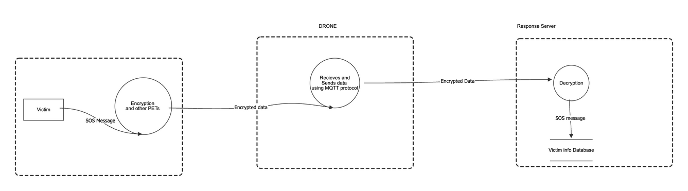
System architecture

Slide 5
Demo showcasing Disaster comminucation system before implementing LINDDUN framework

Slide 6
LINDDUN Framework
Using the LINDDUN framework these were the areas needed improvement
Identifiability: user_id directly reveals a person’s identity.
Linkability: Messages from the same user can be linked over time.
Disclosure of information: Location and message are highly sensitive.
Detectability: An attacker listening on disaster/alerts can detect events.
Unawareness: Users don’t know how their data is used or stored.
Non-repudiation: Logs could falsely be used against users.

Slide 7
Privacy enhancing techniques
I implemented five privacy-enhancing technologies:
Pseudonymization: The user_id is hashed using SHA-256.
Payload Encryption: The message is encrypted with AES using Fernet.
Topic Hashing: Even the topic name is hashed to hide routing intent.
Data Minimization: Only essential fields (id, loc, msg) are sent.
TLS Simulation: client.tls_set() is added to simulate secure transport.

Slide 8
Demo showcasing disaster communication system after implementing privacy enhancing techniques

Slide 9
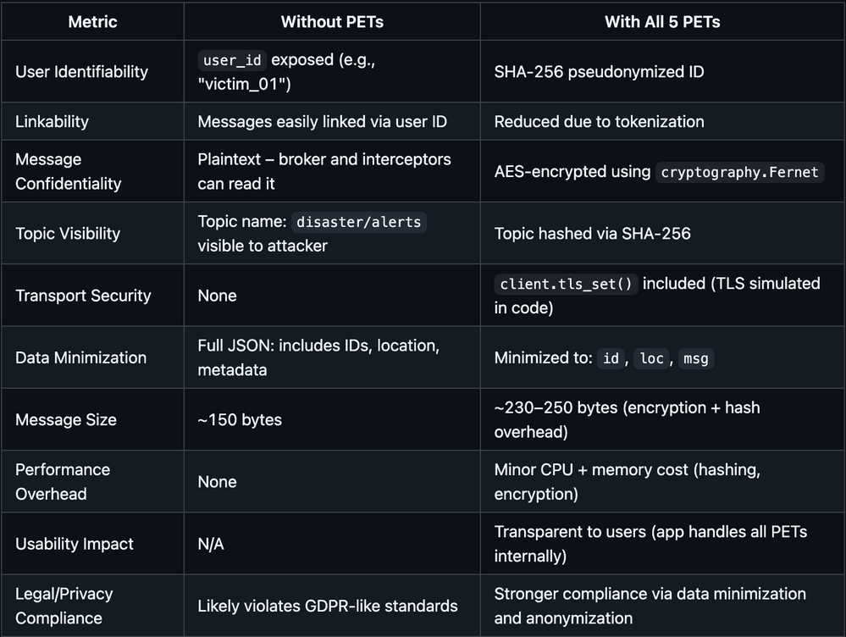
Results [Before vs After]

Slide 10
Strength vs tradeoff
The PETs were effective, but came with trade-offs:
Strengths:
Secured message contents
Preserved functionality
User experience unchanged
Trade-offs:
Larger message size
Required extra logic and key management

Slide 11
Final Remarks
To wrap up:
MQTT is fast but dangerous if left unprotected.
LINDDUN helped identify where privacy was weak.
PETs like encryption and tokenization effectively protected sensitive data.
With minimal usability impact, we achieved a high-privacy, deployable disaster comms system.

Slide 12
Thank You

